Slide 1
Fire Prevention System
IoT based Fire Prevention System
Using ESP32 and Blynk Cloud

Slide 2
Introduction
Our project aims to develop an efficient fire detection system using fire, smoke, and environmental sensors for early detection of potential hazards. By integrating fire and smoke sensors with a DHT11 sensor for temperature and humidity monitoring, our system provides comprehensive environmental awareness. Utilizing visual feedback through green and red LEDs and audio feedback via a buzzer, our system promptly alerts users to the presence of fire or smoke. With a focus on reliability, accuracy, and user-friendliness, our solution strives to enhance fire safety measures in various environments while remaining cost-effective and compliant with safety standards.

Slide 3
Objective
Develop a system capable of detecting the presence of fire and smoke in its vicinity using fire and smoke sensors.
Utilize the DHT11 sensor to monitor temperature and humidity levels in the surrounding environment to provide context for fire detection.
Implement a visual feedback mechanism using green and red LEDs to indicate the status of the environment, with green indicating normal conditions and red indicating the presence of fire or smoke.
Incorporate a buzzer to provide audible alerts when fire or smoke is detected, enhancing situational awareness for users.
Enable real-time monitoring of sensor data to ensure prompt detection and response to potential fire hazards.

Slide 4
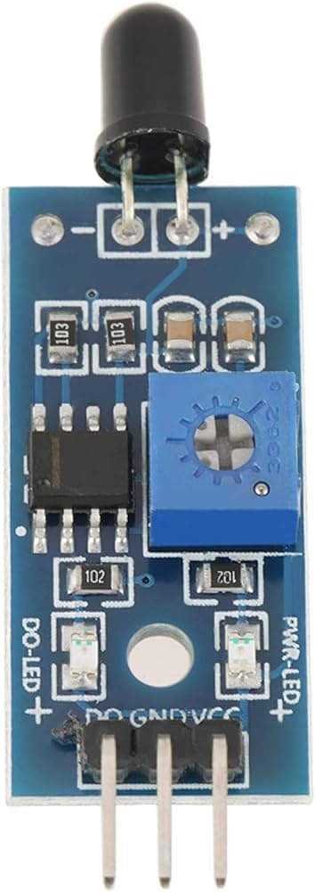
1. Fire Sensor
A fire sensor, also known as a flame detector, is a crucial component in fire detection systems designed to detect the presence of flames or fire outbreaks. These sensors operate on various principles such as detecting infrared (IR) radiation emitted by flames or sensing changes in ambient temperature. Some fire sensors utilize ultraviolet (UV) light detection, which is particularly effective for detecting flames that emit UV radiation during combustion.

Slide 5
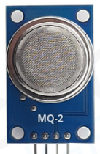
2. Smoke Sensor
A smoke sensor, also referred to as a smoke detector or smoke alarm, is a vital component of fire detection systems designed to detect the presence of smoke particles in the air. These sensors utilize various detection methods, including photoelectric sensing, ionization, or a combination of both, to identify the presence of smoke particles resulting from combustion processes.

Slide 6
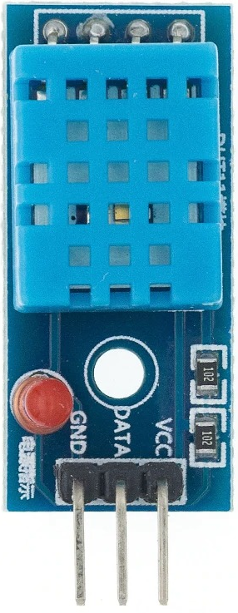
3. DHT11 Sensor
The DHT11 sensor is a versatile and cost-effective component used for measuring temperature and humidity levels in the surrounding environment. It comprises a calibrated digital sensor with a built-in thermistor for temperature measurement and a capacitive humidity sensor for humidity measurement.
The DHT11 sensor operates by converting temperature and humidity readings into digital signals, which can be easily read by microcontrollers or other digital devices. It communicates via a single-wire digital interface, making it simple to integrate into various electronic projects and systems

Slide 7

4. Buzzer
A buzzer is an electromechanical device that produces sound when an electrical current is passed through it. It consists of a vibrating element, typically a thin metal disk or a piezoelectric crystal, enclosed in a housing. When an electric signal is applied to the buzzer, the vibrating element rapidly vibrates, creating sound waves and producing an audible tone.

Slide 8

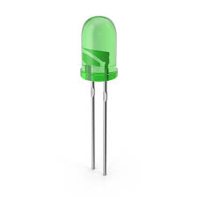
5. Green and Red LED
A green LED (Light-Emitting Diode) is a semiconductor device that emits green light when an electric current passes through it in the forward direction. A red LED (Light-Emitting Diode) is a semiconductor device that emits red light when an electric current passes through it in the forward direction.

Slide 9
Block Diagram
Fire Sensor
ESP32
Red LED
DHT11 Sensor
Green LED
Smoke Sensor
Buzzer

Slide 10
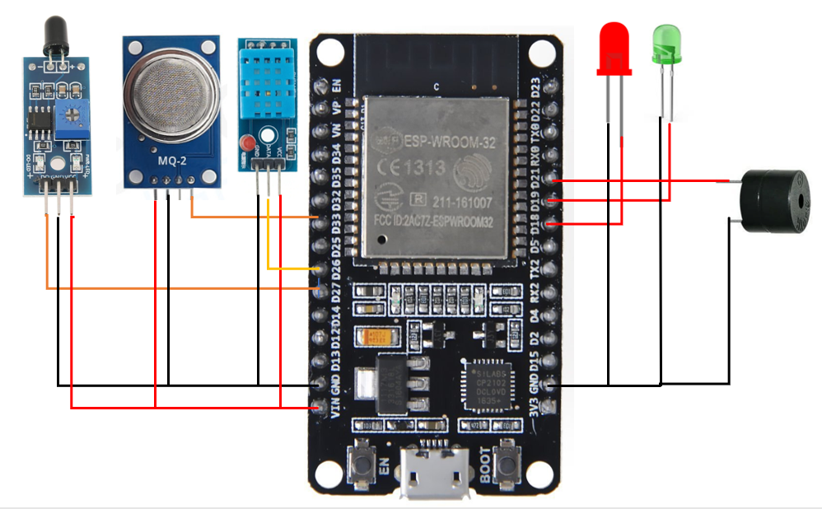
Circuit Diagram

Slide 11
Circuit Diagram Explanation
This code sets up a fire detection system using an ESP32 microcontroller and various sensors. It incorporates a DHT11 sensor to measure temperature and humidity, a smoke sensor to detect smoke levels, and a flame sensor to identify flames.
LED indicators (red and green) and a buzzer provide visual and audible feedback respectively. The system integrates with the Blynk platform for remote monitoring and control. In the main loop, sensor readings are continuously monitored, and if smoke or flames are detected, the red LED and buzzer activate, and a fire alert message is sent to the Blynk app. Conversely, the green LED indicates a safe environment.
Sensor data and system status updates are sent to the Blynk app via virtual pins, enabling users to monitor environmental conditions and fire detection status remotely. Overall, this system ensures real-time monitoring of fire hazards, empowering users to respond promptly in case of a fire emergency.

Slide 12
Advantages
Early detection of fire hazards.
Remote monitoring via the Blynk platform.
Clear visual (LED) and audible (buzzer) feedback.
Customizable alerts for specific notifications.
Integration with existing fire safety infrastructure.
Cost-effective implementation with affordable components.
User-friendly interface for easy monitoring and control.

